Slide 1

EXPLORATORY DATA ANALYSIS ON TITANIC DATASET
SUBMITTED TO CODE APRIL INSTRUCTOR:
PROMISE EKEH
SUBMITTED BY:
PAUL ALABI

Slide 2
INTRODUCTION
THE TITANIC SHIPWRECK IS ONE OF THE DEADLIEST HISTORICAL EVENT
IMPORTANCE OF EDA IN ANALYZING THE DATASET
WHAT IS THE IMPORTANCE OF STORY TELLING ?

Slide 3
AIM AND OBJECTIVES
The purpose of the project is to examine passenger profiles, survival rate and factors affecting outcomes
Perform and explain the EDA process on the dataset to discover insights and provide a detailed analysis through story telling

Slide 4
REQUIRED LANGUAGE AND TOOLS?
Anaconda Navigator
Jupyter Notebook
Pandas Library
Numpy Library
Matplotlib Library
Seaborn Library

Slide 5
WHAT IS EXPLORATORY DATA ANALYSIS?
Exploratory Data Analysis (EDA) is a crucial technique used by data scientists to analyze and investigate data sets. It allows them to explore the data, identify patterns, spot anomalies, test hypotheses, and mine for data-driven insights.

Slide 6
STEPS REQUIRED IN EDA IMPLEMENTATION
ACQUIRE DATA
IMPORT THE REQUIRED LIBRARIES
IMPORT THE DATA
CLEAN THE DATA
VISUALIZE THE DATA
PERFORM UNIVARIATE, BIVARIATE AND MULTIVARIATE ANALYSIS
DRAW INSIGHTS AND REPORT YOUR FINDINGS

Slide 7
DATA VISUALIZATION
CORRELATION
SURVIVAL COUNT
SURVIVAL BY EMBARKED COUNT
PCLASS COUNT
SURVIVAL BY PCLASS
SURVIVAL BY SEX
EMBARKED BY EMBARKED

Slide 8
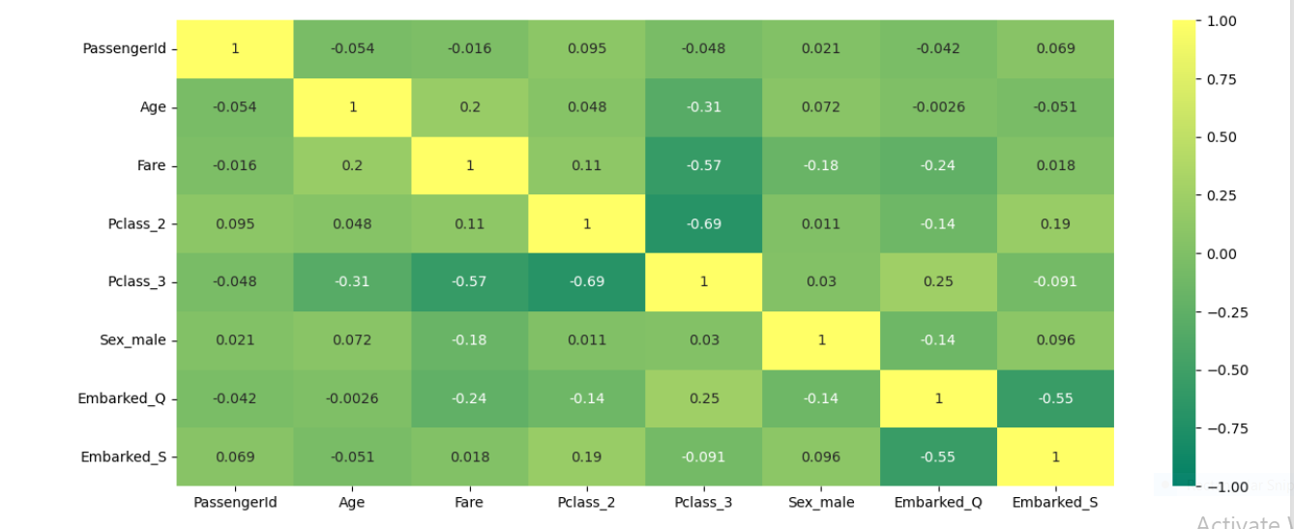
CORRELATION PLOT USING HEATMAP

Slide 9
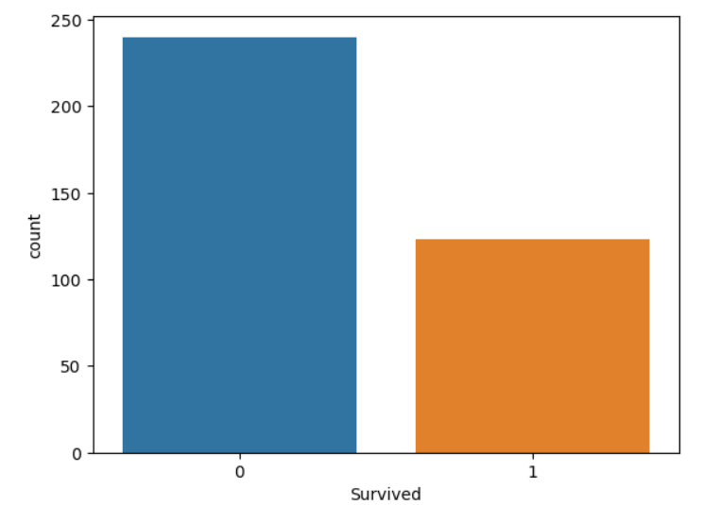
SURVIVAL COUNT

Slide 10
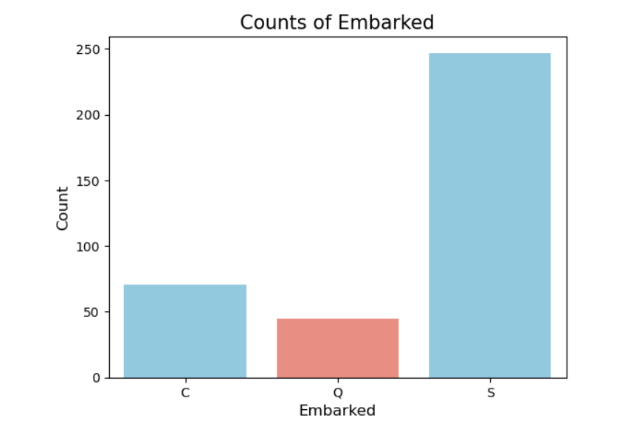
SURVIVAL COUNT BY LOCATION OF EMBARKMENT
S – SOUTHAMPTON C – CHERBOURG Q - QUEENSTOWN

Slide 11
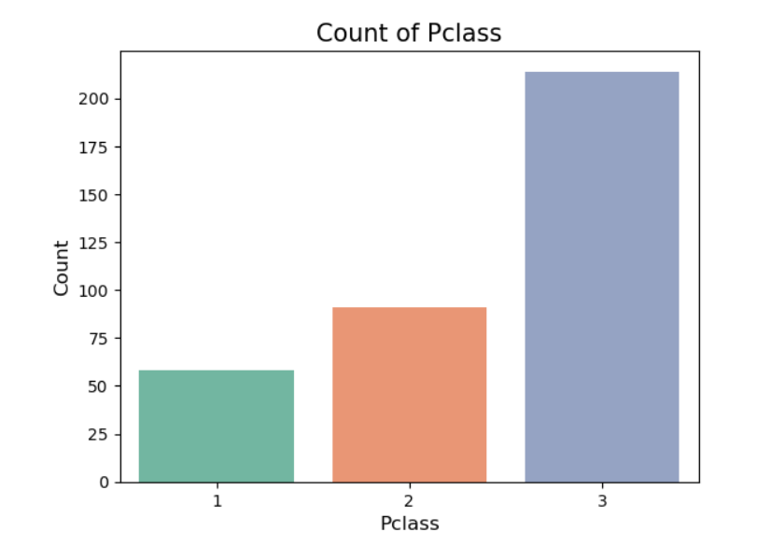
SURVIVAL COUNT BY PCLASS

Slide 12
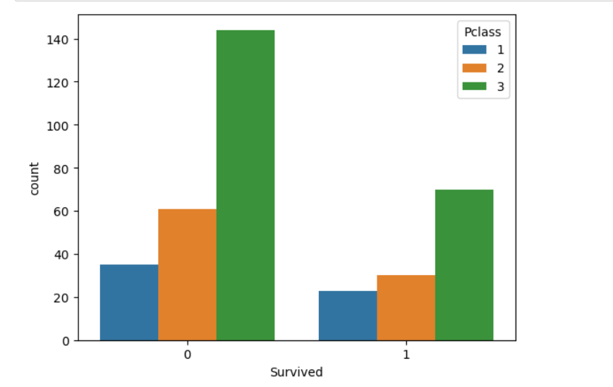
SURVIVAL COUNT BY PCLASS

Slide 13
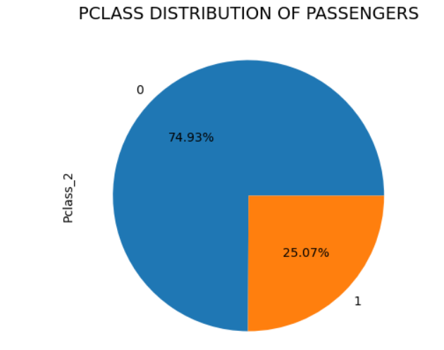
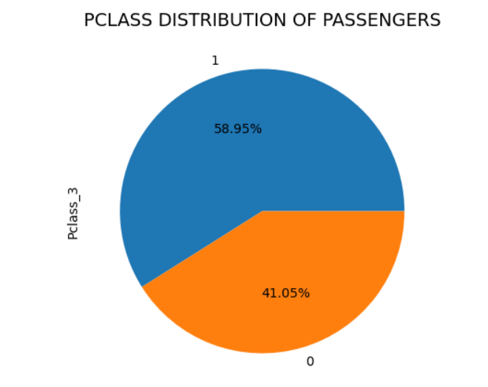
SURVIVAL BY PCLASS
PCLASS_2
PCLASS_3

Slide 14
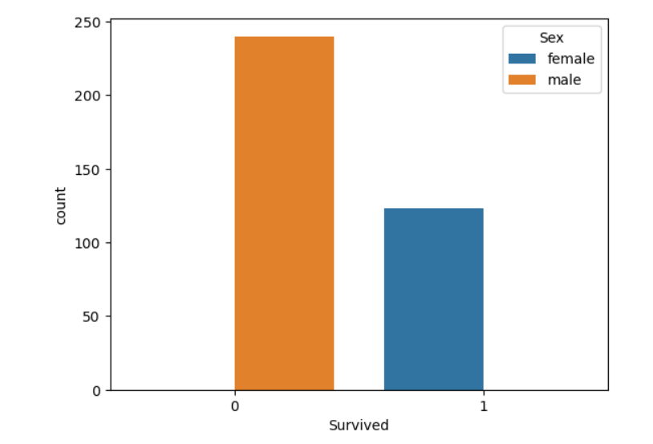
SURVIVAL BY GENDER

Slide 15
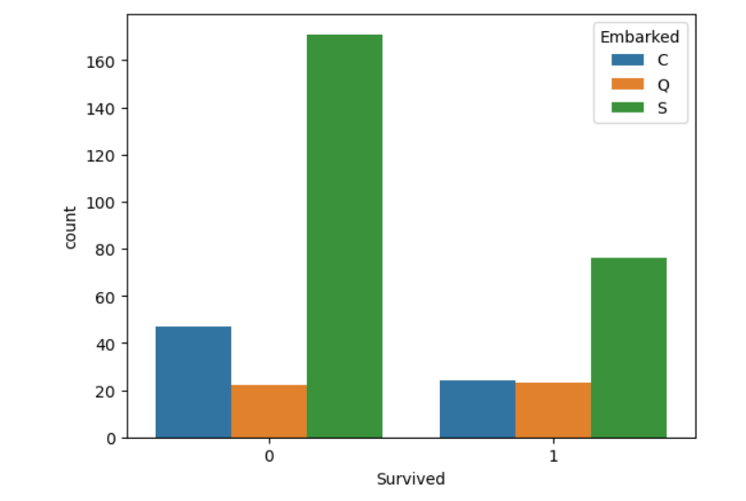
SURVIVAL BY AREA OF EMBARKMENT

Slide 16
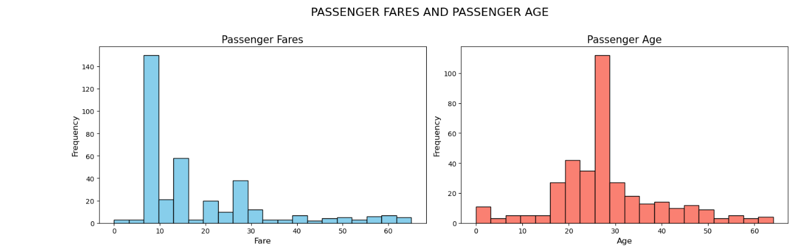

Slide 17
INSIGHTS FROM YHE TITANIC DATASET ANALYSIS
More females survived
Most passengers in Titanic were between ages 20 and 30
Most Passengers boarded at less than $30
Most survivors embarked on the journey from Southampton
The number of deaths were greater than the number of those who survived
People from Pclass_3 had the highest survival and death count
People from Southampton died the most and survived the most

Slide 18



